Slide 1
Stop Shoving Thickened Liquids Down My Throat: Dysphagia in the Aging Population
Joy Carter, M.S., CCC-SLP

Slide 2
Disclosures
GSHA Member
Received a Discount on GSHA registration
I am not affiliated with any of the products, services, or publications mentioned in this presentation.

Slide 3
What is Dysphagia?
Dysphagia is a disorder of swallowing, involving a disruption of anatomy or physiology in any stage of the swallowing process.
Oral Prep Phase
Oral Phase
Pharyngeal Phase
Esophageal phase

Slide 4
What is Dementia?
Dementia is a gradual loss of cognitive function.
  Loss of social, emotional, self-care, and motor skills
  Many etiologies, few of which are reversible
  Diagnostic process is complex and completed by a team of physicians: neuropsychology exam, brain imaging, blood testing and metabolic testing

Slide 5
Dysphagia in the Dementia Population
In the general population, approximately 15% of adults over 60 are affected by dysphagia (Barczi, Sullivan, & Robbins, 2000).
In persons with a dementia diagnosis, the prevalance of dysphagia is as high as 57% (Alagiakrishnan, Bhanji, & Kurian, 2013).

Slide 6
How Does Dysphagia Affect Patients With Dementia?
Weight loss
Dehydration
Aspiration pneumonia

Slide 7
Preventing Dehydration: Frazier Free Water Protocol
Developed at Frazier Rehab Institute, Louisville, KY
How does it work?
  Patients on an oral diet may have thin water before and 30 minutes after meals.
  Patients must complete oral care before the first meal of the day, and after each meal.
  Food and medications are consumed with thickened liquids.
  If a patient benefits from compensatory strategies, they are to perform those strategies while drinking thin water.
  NPO patients may participate as well, with good oral care.

Slide 8
Frazier Free Water Protocol
Who is a good Candidate?
  Residents who understand the purpose and procedures of the protocol and remember to use strategies
  MUST train staff on the protocol and oral care
Is it safe and effective?
  Water has a neutral pH, and small amounts of it are rapidly absorbed from the airspaces in the lungs (Effros et al., 1997).

Slide 9
Frazier Free Water Protocol
Patients using the Free Water Protocol demonstrated increased fluid intake compared to patients who only drank thickened liquids (Bronson-Lowe et al, 2008; Garon, Engle, Ormiston, 2007).
The Free Water Protocol facilitates maximal hydration and increases patient satisfaction.

Slide 10
Aspiration Pneumonia: Why Is Everyone Concerned?
Aspiration pneumonia (APNA) occurs when a person inhales foreign matter into the lungs, causing the alveoli (air sacs) to fill with fluid or pus.
It is the leading cause of death in persons who reside in long-term care facilities (Pace & McCullough, 2010).
Skilled nursing facilities are concerned that a resident may aspirate and develop APNA, which is costly for the healthcare system.

Slide 11
Predictors of Aspiration Pneumonia
Langmore, et al. (1998)
  Dependent (requires total assistance) for feeding
  Dependent for oral care
  Number of decayed teeth
  Tube feeding (all types)
  More than one medical diagnosis
  Multiple medications
  Smoking

Slide 12
Preventing Aspiration Pneumonia: Oral Care Is Important
Makeda and Agaki (2014) found that tube-fed patients who received standard oral care twice per day had 40% fewer hospitalizations and half as many cases of pneumonia than patients who had no specific oral care protocol.
Ashford (2017) insists that “Oral care is not a care. Oral Care should be considered an infection control protocol.”

Slide 13
What Is Good Oral Care?
Ashford (2017) defines good oral care:
  Use a small sponge to remove dried secretions
  Use a toothbrush and toothpaste (oral suction as needed)
  Rinse with a mouthwash that does not contain alcohol
  Yoneyama et al. (2002) found that 9% of nursing home patients developed pneumonia when receiving an oral care protocol, compared to 20% of those who received no oral care protocol.

Slide 14
What is the Hierarchy of Dysphagia Management?
Logemann (1993) advised clinicians to approach compensatory strategies in the following order:
  Postural techniques
  Techniques to enhance oral sensation
  Swallowing Maneuvers
  Diet modifications

Slide 15
Dysphagia Management: Staging Dementia
Global Deterioration Scale (GDS) ranges from 1=no cognitive decline to 7=severe cognitive decline (Resiburg, et al. 1982).
The Large Allen Cognitive Level Screen-5 (LACLS-5) gives a score of 2.8-6.0, which corresponds to the Allen Cognitive Level Battery (Allen et al., 2007).

Slide 16
Stages of Dementia
Early stage dementia
  GDS 2-3/LACLS-5 4.0-4.8
Moderate dementia
  GDS 4-6/LACLS-5 3.0-3.8
Severe (end stage) dementia
  GDS 7/LACLS-5 2.0-2.8

Slide 17
Dysphagia Management: Chief Complaints
Weight loss
Coughing during meals
Spitting out food
Pocketing

Slide 18
Dysphagia Management: Clinical Evaluation
Do a thorough chart review, interview nursing staff and family/responsible party by phone.
Previous swallow study? (If new admit)
Check for indicators of aspiration pneumonia!
Does the patient follow directions?
Responsive to cuing?
Complete a cranial nerve exam.

Slide 19
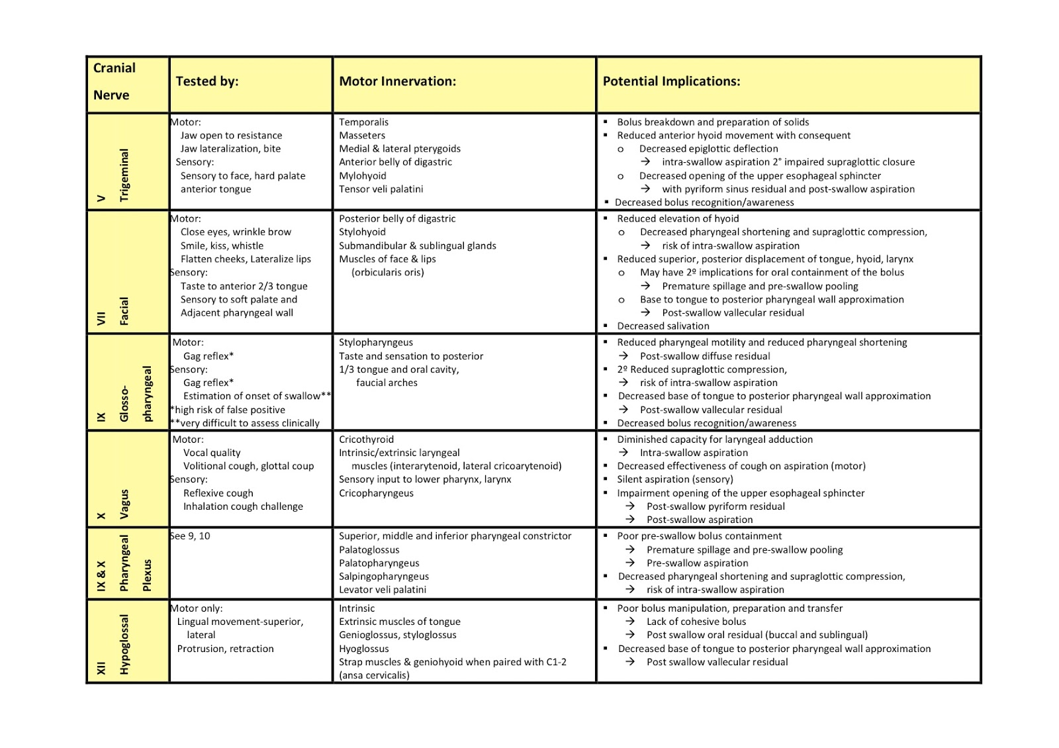
Source: Brain Salt Blog

Slide 20
Dysphagia Management: Imaging
Get an instrumental exam to recognize why the patient is coughing.
Signs of dysphagia do not necessarily indicate that aspiration is occurring.
Imaging is to assess the anatomy and physiology of the swallow, not simply to rule out aspiration.

Slide 21
Dysphagia Management: Imaging
For MBSS:
  Send a note to the hospital SLP.
  Ask for consistencies and strategies that you would like them to try.
  Maintain rapport with hospital SLP; if you have questions about the report, do not hesitate to call and ask.

Slide 22
Dysphagia Management: Imaging
A patient DOES NOT need to follow directions to participate in a swallow study, he just needs to eat.
Get a copy of the report before proceeding, so you know which deficits to treat.
Advocate for your patients and for yourself! If you knowingly provide substandard treatment due to lack of instrumental exams, any adverse effects may become your responsibility.

Slide 23
Dysphagia Management: Early Stage Dementia
Patients CAN learn new information
Exercise Programs: note the occurrences that happened during the instrumental exam, and research the anatomy/physiology deficits that caused them.
Swallow Your Pride podcast and Dysphagia Therapy app have great resources for exercise planning.

Slide 24
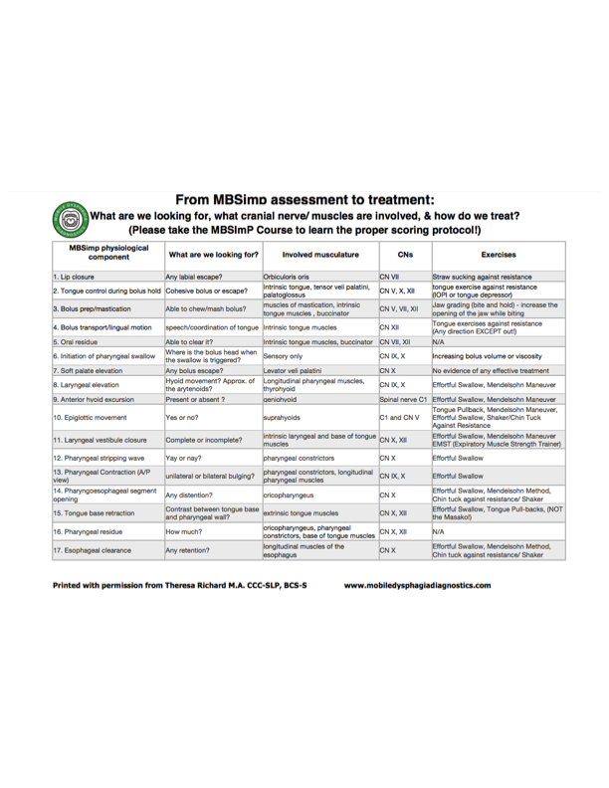

Slide 25
Early Dementia: Postural Techniques
Make sure that the techniques are indicated during an instrumental.
  Chin tuck (down)
  Head turn
  Posterior head tilt
Some techniques can do more harm then good if not used properly.
  Chin tuck may cause aspiration rather than prevent it if the patient has significant residue in the pyriforms (Coyle, 2014).
  Contraindicated for weak pharyngeal contraction, reduced tongue control or AP transit, poor labial seal, and significant pharyngeal delay/pyriform spillage (Logemann, 1993; Shanahan et al., 1993)

Slide 26
Early Dementia: Techniques to Enhance Oral Sensation
Use the results of the cranial nerve exam to determine which sensory deficits to address.
Carbonated beverages are NOT the same as nectar thick liquids, but they do provide increased sensory stimulation to Cranial Nerve V.
  Carbonated beverages have been shown to reduce penetration and aspiration when consumed in small amounts (Sdravou & Walshe, 2012).

Slide 27
Early Dementia: Swallowing Maneuvers and Other Strategies
If the patient can follow multi-step directions, consider the supraglottic or super-supraglottic swallow (contraindicated for cardiac diseases).
Effortful swallow
Mendelsohn maneuver
Alternate solids and liquids
Double swallow

Slide 28
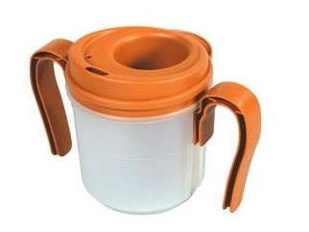
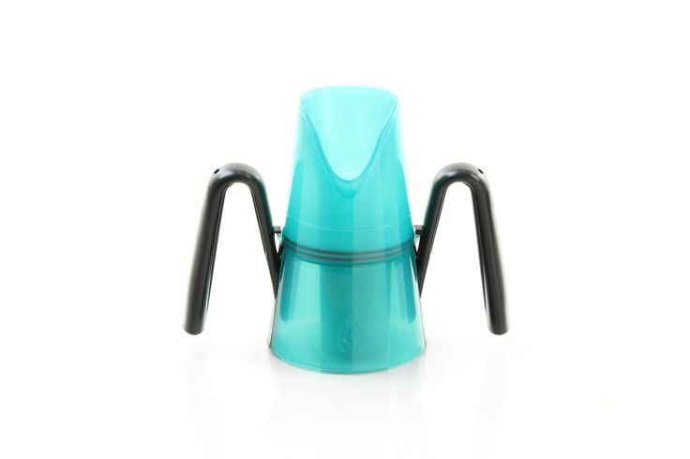
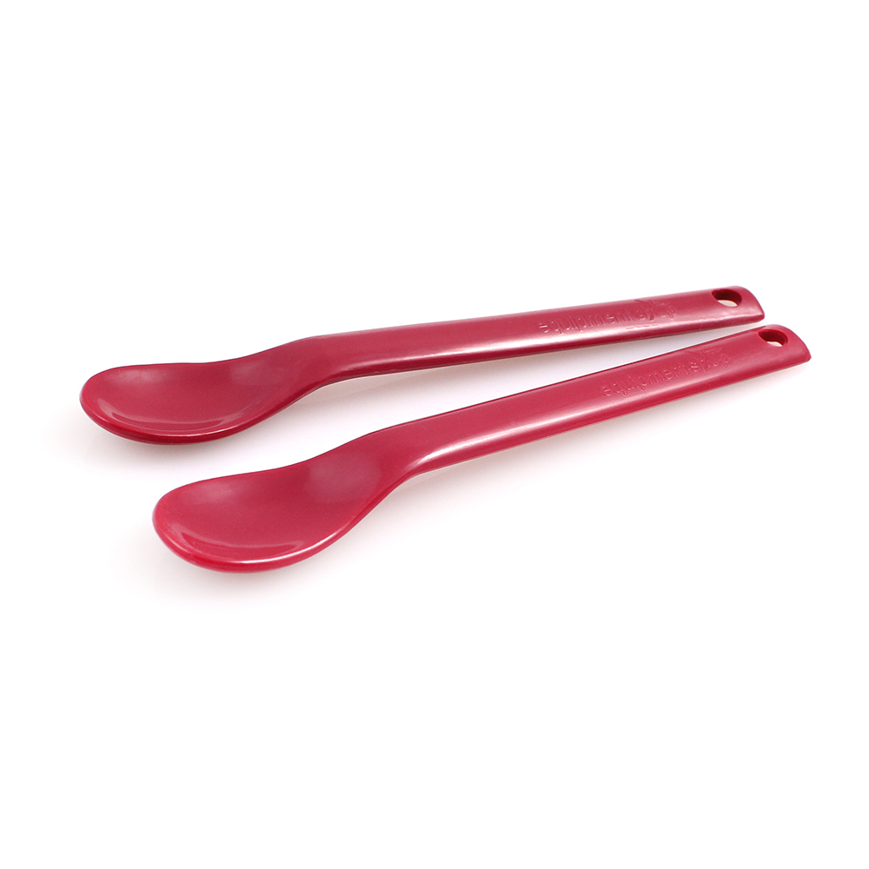
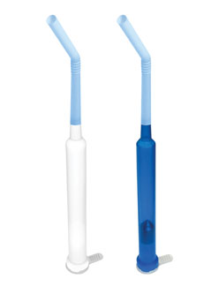
Volume Control
  RiJe cup (thin or nectar thick)
  Maroon Spoon
Provale cup (thin liquids only)
  Adaptive straws (thin and nectar thick)

Slide 29
Early Dementia: Diet Modification
Explain WHY you recommend a consistency.
Use anatomical diagrams.
Explain why aspiration is not ideal.
Make it clear that the patient has a choice.
Consider patient satisfaction and quality of life.

Slide 30
Why Modified Diets?
Thickened liquids flow at a slower pace than thin liquids, giving a person more time to manipulate the bolus, initiate a swallow, and protect the airway.
Diet levels: National Dysphagia Diet (NDD), International Dysphagia Diet Standardization initiative (IDDSI)
For this presentation: we will use puree, mechanical soft, regular, thin, nectar, and honey.

Slide 31
Diet Modifications: Are They Really Safer?
Logemann et al. (2008) Studied the efficacy of thickened liquids and chin tuck in preventing aspiration in patient with dementia and Parkinson’s disease.
Honey thick liquids were more effective than the chin tuck and nectar thick liquids in preventing aspiration; HOWEVER, over 50% of the dementia patients (with or without Parkinson’s) still aspirated with all three interventions.

Slide 32
Diet Modifications, contd.
A second study by Robbins, et al. (2008) found that while honey thick led to fewer instances of aspiration, patients who did aspirate honey thick had higher rates of aspiration pneumonia after three months.
Patients prescribed thickened liquids also had higher rates of dehydration, UTI, and fever.

Slide 33
Diet Modifications, contd.
Sharpe, Ward, Cichero, Sopade, and Halley (2007) found that thickened liquids do not affect the bioavailability of water.
Thickened liquids do affect the bioavailability of medication (Cichero, 2013).
Thickened liquids often leave residue, which a person can aspirate later.
Aspirating thickened liquids means introducing thickening agents to the lungs.

Slide 34
Considerations for Thickened Liquids
What does the FEES/MBSS say?
Garcia, Chambers, and Molander (2005) proposed that thickened liquids are indicated for patients with:
  Reduced oral control of the bolus
  Delayed initiation or slow timing of the pharyngeal phase
  Reduced airway protection during the swallow (MBSS)
  Sensory or cognitive deficits interfering with bolus preparation

Slide 35
Considerations for Thickened Liquids
What is the patient’s cognitive status?
Risk/benefit analysis?
Increased effort is needed to swallow thickened liquids.
Goal: promote optimal nutrition and hydration at the current level of care.

Slide 36
Dysphagia Management: Moderate Dementia
Short attention span
Patients need assistance setting up trays and adaptive equipment.
Patients can complete exercises and postural techniques with increased cuing.

Slide 37
Moderate Dementia: Techniques to Enhance Oral Sensation
Sour bolus
  Increased peripheral stimulation of CN V
  Improved oral phase, reduced pharyngeal swallow delay, and reduced frequency of aspiration (Corbin-Lewis et al., 2005; Logemann et al., 1995).
  Sour and salty tastes increased tongue pressures against roof of mouth compared to milder tastes (Pelletier and Dhanaraj, 2006).
  Compared to other tastes, a cold, sour bolus significantly shortened pharyngeal transit time in middle aged and elderly patients (Cola et al., 2010).

Slide 38
Moderate Dementia: Techniques to Enhance Oral Sensation
Thermal tactile stimulation (TTS)
  Stimulating the faucial pillars with a cold object increases bicortical activation to improve oral and pharyngeal phases of swallowing (Teismann et al., 2009).
  TTS significantly reduced pharyngeal transit time and pharyngeal delay with fluids and puree paste (Regan et al., 2010).
Also used to promote bolus awareness
CAVEAT: Long term effects have not been reported; research has mixed results; some patients gag

Slide 39
Moderate Dementia: Swallowing Maneuvers and Other Strategies
Patients cannot do supraglottic swallow, etc. if they cannot follow multi-step directions.
Patients may benefit from adaptive equipment but require cues to use it correctly.

Slide 40
Moderate Dementia: Diet Modifications
Patient education will need to be repeated several times.
Patients at this stage may not voice dissatisfaction with diets, but they will show you!

Slide 41
Dysphagia Management: Severe Dementia
Patients will only respond to tactile cues, if at all.
Caregiver education is the bulk of your job.
Patients at this stage will not benefit from an exercise program, as they cannot follow directions.

Slide 42
Severe Dementia: Postural Techniques
Ensure that positioning is adequate for oral intake.
Consult OT for positioning if adaptive equipment is needed.

Slide 43
Severe Dementia: Techniques to Enhance Oral Sensation
Provide tactile stimulation to lips and tongue to encourage bolus acceptance.
Try sour bolus or temperature changes to elicit a swallow response.
Use a Maroon Spoon if the patient will not open his mouth sufficiently.
Sprinkle sugar on foods to increase intake.
Consult nursing staff and dietician for supplements if weight loss persists.

Slide 44
Severe Dementia: Other Compensatory Strategies
Teach caregivers:
  Cyclic ingestion
  How to use adaptive equipment
  How to alter bolus sizes
  How to create positive dining routines
  How to provide consistent cues and redirections

Slide 45
Severe Dementia: Diet Modification
May be necessary if the patient cannot use strategies to facilitate consumption of a higher level.
Diet changes are fine, as long as the patient is amenable to the diet and is receiving adequate nutrition and hydration.

Slide 46
Severe Dementia: Diet Modification
If a person refuses the modified diet, explain to the responsible party (RP) again what the swallow impairments are and why you recommend a modified diet.
After receiving thorough education and awareness of all options, it is ultimately the patient/RP’s choice how to proceed.

Slide 47
Dysphagia Management: Family Education
Explain ALL options.
Do not change diets with no explanation.
Explain imaging results with anatomical diagrams and use patient-friendly language.
Do not imply that the patient will aspirate and die if they do not drink thickened liquids.
Document EVERYTHING.

Slide 48
Dysphagia Management: Discharge
Provide written instructions for exercises.
Develop a restorative plan to maintain functional gains.
Complete staff training:
  Impromptu In-service
  High staff turnover=ongoing education
  Make it fun!
Discharge after everyone has been educated and all documentation is signed.

Slide 49
Waiver Your Diet Noncompliance Goodbye
When you make diet recommendations, it is a recommendation. It is NOT the law.
Do not “railroad” patients into making a decision.
Is compliance really a thing?
Waivers may not hold up in court, because the patient does not have equal rights when presented with a waiver (Horner, 2016).

Slide 50
QUALITY OF LIFE
Patients’ level of satisfaction with a diet will directly influence their level of compliance (Colodny, 2005).
Patients with Parkinson’s disease stated that they would rather risk aspiration pneumonia than to drink thickened liquids (Logemann, 2008).

Slide 51
QUALITY OF LIFE, contd.
In a skilled nursing facility, patients are going to consume these diets long-term.
If a patient refuses the recommended diet, something is not working and a different approach is warranted.
Consider long-term implications of thickened liquids.
Optimal nutrition and hydration is a major part of long-term care therapy.

Slide 52
Case Study: Early Stage Dementia
Patient A
90-year old male, long term SNF resident with dementia, HTN, COPD; CVA 2 years ago that resulted in R hemiparesis
Scored 3 on the GDS/4.6 on LACLS-5
Diet is regular/thin
After an episode of consistent coughing during dinner on a Friday, nurse downgraded him to puree/nectar for “safety” and he hated it.

Slide 53
Patient A
He refused thickened liquids all weekend; nurses were worried about dehydration.
Aspiration pneumonia assessment:
  Independent for feeding and oral care
  No peg tube
  4 medical diagnoses
  8 medications
  No teeth; full set of dentures
  Smoked for 20 years

Slide 54
Patient A
Clinical evaluation
  Significant pocketing of regular and mechanical soft; cleared each with lingual sweeps and liquid washes x3
  No pocketing with puree
  Coughs after drinking thin liquids in 5/5 trials
  No coughing with nectar thick liquids
  Labial closure is WFL

Slide 55
Patient A
Interview of family/staff
  CNA: “He always pockets his food but he clears it out eventually.”
  Nursing reported no signs of COPD exacerbation.

Slide 56
Patient A
FEES exam
      Complete VF closure during phonation
      Premature spillage of thin liquids into the pyriforms
      Aspiration of thins before swallow, some silent, coughed 50% of the time
      Adaptive equipment unsuccessful in preventing aspiration
      Chin tuck unsuccessful in preventing aspiration
      Pyriform residue of thins, cleared with double swallow
      No penetration of nectar thick liquids, however there is residue in the pyriforms which took multiple cued swallows to clear

Slide 57
Patient A
FEES Results, contd.
      Significant pyriform residue with honey thick liquids, which he then aspirated after the swallow
      No penetration, aspiration, or residue with puree
      Adequate mastication of mech soft and regular solids (as evidenced by a puree textured bolus being swallowed on the fees)
      No penetration, aspiration, or residue of mech soft and regular
      FEES recommended regular/nectar liquids

Slide 58
Patient A
Treatment
  Explained to family and staff the predictors of aspiration pneumonia, and that it’s highly unlikely that this is the first time he ever aspirated, given Hx of CVA and COPD.
  Diet upgraded to regular/thin.
  The patient was “disturbed” by his aspiration and wanted to “fix it.”
  Exercise program: Lingual resistance exercises, Effortful swallow, Mendelsohn maneuver (he can follow multi-step directions)
  Supraglottic and super supraglottic swallows are contraindicated due to HTN.

Slide 59
Patient A
Compensatory strategies
  Positioning: sitting up straight in WC for all meals
  Pocketing: lingual sweeps, liquid washes

Slide 60
Patient A
Follow-up FEES
  No premature spillage of any solid or liquid texture
  Penetration of thin, no aspiration
  Pyriform residue of thins, cleared with double swallow
  No penetration, aspiration, or residue of regular solids
  FEES recommended regular/thin liquids

Slide 61
Patient A
  Provided a written copy of all compensatory strategies; nursing reported patient was independent and completed compensatory strategies 90% of the time when provided with worksheet.
  Established a restorative plan to continue exercises for 6 weeks, trained staff on exercise techniques, discharged.

Slide 62
Case Study: Moderate Dementia
Patient B
85 year old female, has Parkinson’s disease and dementia, CVA 1 year ago, peg tube at baseline, R labial weakness and drooling at baseline
Scored 4 on GDS/3.6 on LACLS-5
Long-term SNF resident, developed pneumonia (NOT APNA), had MBSS in hospital, and returned to SNF NPO

Slide 63
Patient B
    Aspiration pneumonia assessment
      Independent for feeding and oral care
      Teeth are in good condition
      Peg tube +
      4 medical diagnoses
      6 medications
      Never smoked

Slide 64
Patient B
MBSS in Hospital
  Puree, mechanical soft (baseline), nectar, thin (baseline)
  Oral escape of thin liquids from R side
  Tongue “rocking” motion, impaired bolus formation and AP transport of all consistencies
  Piecemeal deglutition
  Penetration of nectar liquids before swallowing; cleared with an independent cough
  Residue of nectar in pyriforms cleared with an independent cough

Slide 65
Patient B
MBSS in Hospital, contd.
  Silent aspiration of thin before the swallow
  Residue from thin in pyriforms, not cleared with cough, but spilled over into airway due to cough
  Penetration of mechanical soft before the swallow; not cleared with a cued cough
  Residue of puree in pyriforms cleared with multiple independent swallows
  Impaired upper esophageal sphincter opening

Slide 66
Patient B
Clinical examination
  Bilateral pocketing of mechanical soft and puree
  Puree cleared with cued lingual sweeps
  Unable to clear mechanical soft with cued lingual sweeps and liquid wash x4
  Coughing persisted for several seconds after drinking thin liquids

Slide 67
Patient B
Treatment
  Reviewed MBSS results with patient and her responsible party (RP).
  Initiated puree/nectar diet; the patient expressed satisfaction with nectar thick liquids.
  Used timed swallows for secretion management.

Slide 68
Patient B
  Initiated an exercise program, and scheduled a FEES after 6 weeks to evaluate efficacy
  Lingual exercises against resistance
  Drinking thickened liquids through a straw
  Shaker exercises

Slide 69
Patient B
FEES results
  Piecemeal deglutition of puree and mechanical soft
  No penetration, aspiration, or residue from nectar thick liquids
  Aspiration of thin before the swallow, residue of thin in pyriforms after the swallow
  Independent coughs were unsuccessful in removing thin liquid residue, and caused residue to spill over into the airway
  No penetration, aspiration, or residue from mechanical soft or puree

Slide 70
Patient B
  Provale cup and chin tuck did not help with management of thin liquids.
  Patient could not follow multi-step directions to complete other maneuvers.
  Diet upgraded to mechanical soft/nectar.
  Continued all exercises, as impairments with thin liquid management remained.
  Instances of coughing (thin liquids) decreased with subsequent trials.
  Scheduled a follow-up MBSS (insurance changed and would not pay for FEES); patient/RP declined.

Slide 71
Patient B
Held a care-plan meeting with patient and her RP.
  Discussed her performance on the FEES and in subsequent therapy.
  Explained that the patient has not lost weight or shown signs of dehydration with her current diet.
  Explained that MBSS was warranted to see if her swallowing physiology had improved with further exercises, and if a diet upgrade was warranted.

Slide 72
Patient B
  Made patient aware that ultimately, diet was her choice.
  Patient and RP declined MBSS and further treatment.
  Educated nursing staff to provide cues to swallow saliva, educated staff on providing cues for double swallows, cued coughs, and liquid washes, discharged.

Slide 73
Case Study: Severe Dementia
Patient C
97 year-old male
New admit to SNF
Stage 7 GDS/2.8 LACLS-5
Previously lived with his daughter (full time caregiver)
Daughter chopped all of his food at home
Smoked 25 years, COPD, HTN, DM II, CVA 3 years ago
Admitted to acute care and diagnosed with aspiration pneumonia, no MBSS or FEES, discharged on puree/nectar based on bedside evaluation

Slide 74
Patient C
Clinical evaluation was unremarkable
  Patient benefitted from maroon spoon during exam; he did not open his mouth wide enough for regular spoon.
FEES exam
  Initiation of swallow when bolus reached the pyriforms (all textures)
  No penetration or aspiration of any consistency
  No residue of any consistency
  His swallow was WFL for his age
  How did he get aspiration pneumonia?

Slide 75
Patient C
Assessment for aspiration pneumonia:
  Dependent for feeding
  Dependent for oral care
  No peg tube
  10 medical diagnoses
  14 medications
  Former smoker

Slide 76
Patient C
Treatment
  Diet upgraded to mechanical soft/thin.
  Educated the patient’s daughter and nursing staff on optimal position for oral intake, adaptive equipment, and the importance of oral care.
  Devised a restorative nursing plan, discharged.

Slide 77
Final Thoughts
Senior citizens have worked hard throughout their lives, and deserve to have enjoyable meals during their retirement, even those in nursing homes, or with dementia. Do not give them substandard treatment by refusing to explore all options.
Aunt Wilma deserves better!

Slide 78
Questions?
Contact:
JoyCarterSLP@gmail.com

Slide 79
References
Alagiakrishnan, K., Bhanji, R. A., & Kurian, M. (2013). Evaluation and management of oropharyngeal dysphagia in different types of dementia: A systematic review. Archives of Gerontology and Geriatrics, 56, 1–9.
Allen, C. K., Austin, S. L., David, S. K., Earhart, C. A., McCraith, D. B., & Riska-Williams, L. (2007). Manual for the Allen Cognitive Level Screen-5 (ACLS-5) and Large Allen Cognitive Level Screen-5 (ACLS-5). Camarillo, CA: ACLS and LACLS Committee.
Ashford, J. (Guest presenter). (2017, September 1). Swallow Your Pride [Audio podcast]. Retrieved from https://www.mobiledysphagiadiagnostics.com/swallow-your-pride-episode-3/
Balou, M, McCullough, GH, Aduli, F., Brown, D, Stack Jr, BC, Snoddy, P & Guidry, T. (2014). Manometric measures of head rotation and chin tuck in healthy participants. Dysphagia, 29, 25-32.
Barczi SR, Sullivan PA, Robbins J. (2000). How should dysphagia care of older adults differ? Establishing optimal practice patterns. Semin Speech Lang. 21, 347–361.
Bronson-Lowe, C., Leising, K., Bronson-Lowe, D., Lanham, S., Hayes, S., Ronquillo, A. & Blake, P. (2008). Effects of a Free Water Protocol for Patientswith Dysphagia (Abstract, Dysphagia Research Society Meeting). Dysphagia,23, 430.
Cichero, JA. (2013). Thickening agents used for dysphagia management: Effect on bioavailability of water, medication, and feelings of satiety. Nutrition Journal, 12(54). doi: 10.1186/1475-2891-12-54
Cola, C.P., Gatto, A.R., Silva, R.G., Spadotto, A.A., Schelp, A.O., Aparecida, M., & Henry, C.A. (2010). The influence of sour taste and cold temperature in pharyngeal transit duration in patients with stroke. Arquivos de Gastroenterologia, 47(1). doi: 10.1590/S0004-28032010000100004
Colodny, N. (2005). Dysphagic independent feeders’ justifications for noncompliance with recommendations by a speech-language pathologist. American Journal of Speech-Language Pathology, 14(1), 61–70.

Slide 80
Corbin-Lewis, K, Liss, J.M., & Sciortino, K.L., 2005, Clinical Anatomy & Physiology of the Swallow Mechanism, Thomson Delmar Learning, Clifton Park, NY.
Coyle, J.L. (2014, April). IIS5: Dysphagia Interventions: Are We Treating the Bolus, the Patient, or Something Else? Seminar presented at the Healthcare & Business Institute of the American Speech-Language-Hearing Association, Las Vegas, NV.
Effros RM, Darin C, Jacobs ER, Rogers RA, Krenz G, Schneerberger EE. (1997);Water transport and the distribution of aquporin-1 in pulmonary air spaces. Journal of Applied Physiology 83:1002-16
Garcia, J.M., Chambers, E., Molander, M. (2005). Thickened liquids: practice patterns of speech language pathologists. American Journal of Speech-Language Pathology, 14, 4-13.
Garon, B., Engle, M., Ormiston, C. (1997). A randomized control study to determine the effects of unlimited oral intake of water in patients with identified aspiration. J Neuro Rehab, 11, 139-148.
Horner, J., et al. (2016). Consent, refusal, and waivers in patient centered dysphagia care: Using law ethics and evidence to guide clinical practice. AJSLP, 25(4).
Langmore, SE, et al. (1998). Predictors of aspiration pneumonia: How important is dysphagia? Dysphagia, 13, 69-81.
Levy, R. (Guest presenter). (2017, November 1). Evidenced-based treatment for every swallowing impairment. Swallow Your Pride [Audio podcast and show notes]. Retrieved from https://www.mobiledysphagiadiagnostics.com/swallow-your-pride-episode-13/
Logemann, J. A. (1993). The dysphagia diagnostic procedure as a treatment efficacy trial. Clinics in Communication Disorders, 3(4), 1-10.
Logemann, J.A. (1993). Manual for the videofluorographic study of swallowing: second edition. Austin, Tx: Pro-Ed.

Slide 81
Logemann, J.A., Pauloski, B.R., Colangelo, L., Lazarus, C., Fujiu, M., Kahrilas, P.J. (1995).Effects of a sour bolus on oropharyngeal swallowing measures in patients with neurogenic dysphagia. Journal of Speech and Hearing Research, 38(3), 556-63.
Logemann, JA, et al. (2008). A randomized study of three interventions for aspiration of thin liquids in patients with dementia or Parkinson’s disease. Journal of Speech Language Hearing Research, 51(1), 173-183.
Makeda, K. & Akagi, J. (2014). Oral care may reduce pneumonia in the tube-fed elderly: A preliminary study. Dysphagia. Advanced online publication. Doi:10.1007/s00455-014-9553-6
Pace CC, McCullough GH. (2010). The association between oral microorganisms and aspiration pneumonia in the institutionalized elderly: Review and recommendations.
Pellieter, C.A., & Dhanaraj, G.E. (2006). The effect of taste and palatability on lingual and swallowing pressure. Dysphagia, 21, 121-128.
Regan, J., Walshe, M., & Tobin, W.O. (2010). Immediate effects of thermal tactile stimulation on timing of swallow in idiopathic Parkinson’s disease. Dysphagia, 25(3), 207-215.
Robbins, J. et al. (2008). Comparison of two interventions for liquid aspirations on pneumonia incidence a randomized trial. Annals of Internal Medicine, 148(7), 509-518.
Sdravou, K., and Washe, M. (2012). Effects of carbonated liquids on oropharyngeal swallowing measures in people with neurogenic dysphagia. Dysphagia, 27, 240-250.
Shanahan, T.K., Logemann, J.A., Rademaker, A.W., Pauloski, B.R., Kahrilas, P.J. (1993) Chin-down posture effect on aspiration in dysphagic patients. Arch Phys Med Rehabil 74, 736-739.
Sharpe K, Ward L, Cichero J, Sopade P, Halley P. (2007). Thickened fluids and water absorption in rats and humans. Dysphagia, 22, 193–203. DOI: 10.1007/s00455-006-9072-1.
Teismann, I.K., Steinstrater, O., Warnecke, T., Suntrup, S., Ringlestein, E.B., Pantev, C., &Dziewas, R. (2009). Tactile thermal oral stimulation increases the cortical representation of swallowing. BioMedCentral Neuroscience, 10(71). DOI: 10.1186/1471-2202-10-71
Toren, F. (2013, January 26). CN exam. Retrieved from http://brainslt.blogspot.com/2013/01/cn-exam.html
Yoneyama, T., Yoshida, M., Ohuri, T. . . . Sasaki, H. (2002). Oral care reduces pneumonia in older patients in nursing homes. Journal of the American Geriatric Society, 50, 430-433.

